Slide 1
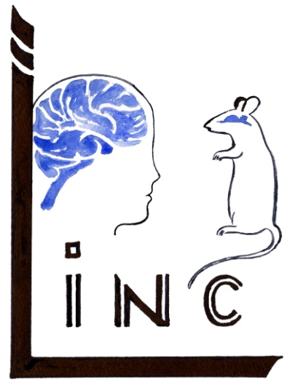



SPIRIT: a time-gated near infrared spectroscopic imaging system for brain activation studies.
F. Nouizi¹, B. Dubois², W. Uhring², P. Poulet¹
1) Laboratoire d’Imagerie et de Neurosciences Cognitives,
2) Institut d’Electronique du Solide et des Systèmes,
Université de Strasbourg, CNRS.

Slide 2
Outlines
Introduction
The SPIRIT project
Human optical Head Phantom
SPIRIT simulations
Discussion

Slide 3
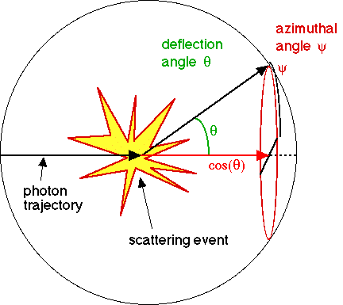
Optical properties of tissues
Definitions:
Absorption coefficient: µ_{a} = 1 / L_{a}
L_{a} : mean free path length of absorption
Scattering coefficient: µ_{s} = 1 / L_{s}
L_{s} : mean free path length of scattering
Reduced scattering coefficient:
µ_{s}‘ = (1-g) µ_{s}
g = cos(θ), θ : mean scattering angle
1

Slide 4
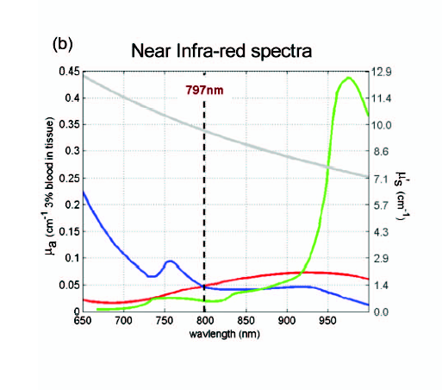
Tissues properties in the Near Infrared
NIR in medicine:
Diagnostic window
(680 - 900 nm)
Low absorption and scattering
µ_{a} < 1 mm⁻¹ and µ_{s}’ < 4 mm⁻¹
NIRS: Near Infrared Spectroscopy
µ_{a} at ≠ λ
µ_{a} of ≠ absorbers
µ_{a}(Hb0₂)
µ_{a}(Hb)
µ_{a}(H₂O). 10⁶
µ_{s}’
Hillman E.M.C., J. Biomed. Opt. 2007
2

Slide 5
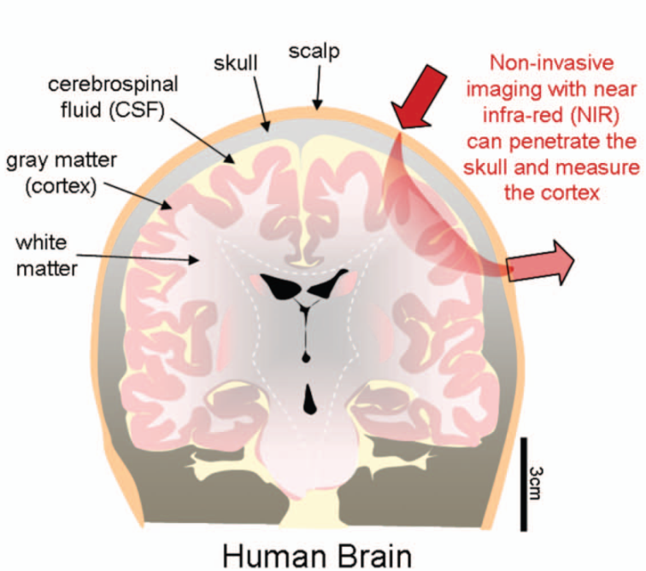
Physiology monitoring by NIRS
Parameters of interest:
1) Absorbers concentration:
[Hb], [HbO₂], [H₂O] …
2) Cerebral physiology:
- Cerebral Blood Volume (CBV)
- Cerebral Blood Flow (CBF)
- Cerebral Metabolic Rate of Oxygen
(CMRO₂)
3
Hillman E.M.C., J. Biomed. Opt. 2007

Slide 6
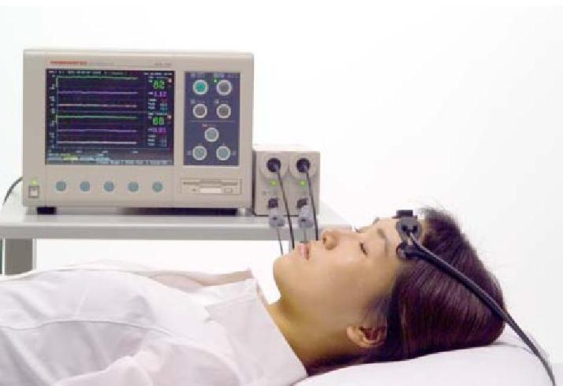
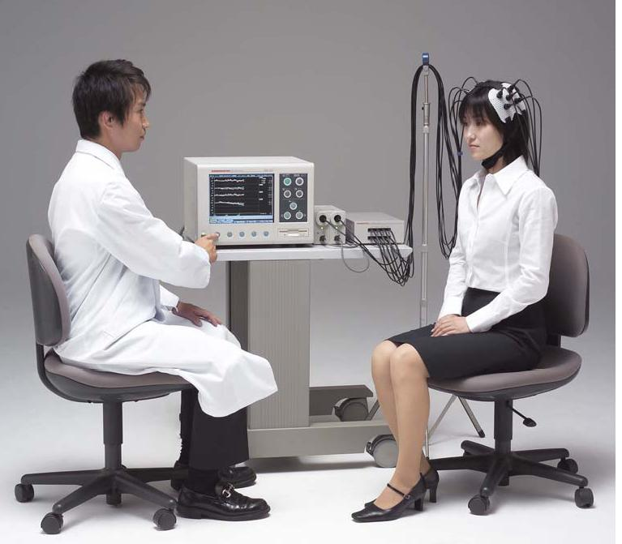
Clinical NIRS Apparatus
Advantages:
Multiple wavelengths: 2 – 4
Disadvantages:
Multiples optodes (in contact):
from 2 (regional measurements)
up to 32 (optical topography)
Hot spot
No depth information
Niro 200, Hamamatsu
+ MultiChannel Adapter
4

Slide 7
The SPIRIT Project
SPIRIT = Spectroscopie Proche Infrarouge par Imagerie Temporelle
The idea
Assemble a whole TR-NIRS system (sources + detectors)
without contact (optical fibers) nor scanning
The advantages
- 3D information made possible without image reconstruction
- No hot spot
5

Slide 8
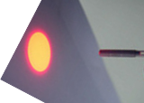
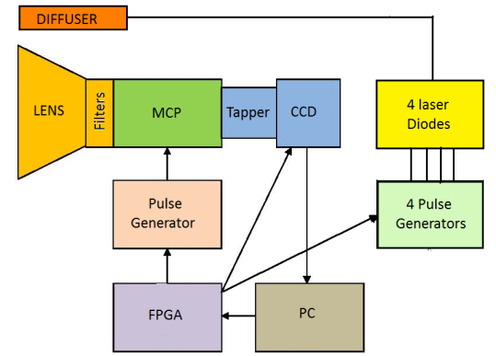
The SPIRIT instrumentation (1/2)
Temporal resolution ≈ 200 ps
Area uniformly illumined by the light distributor
Intensifier with 2 MCP stages
Sub ns pulse: photocathode polarization
ns pulses: driving the laser diodes
FPGA module controlling the whole system
6

Slide 9
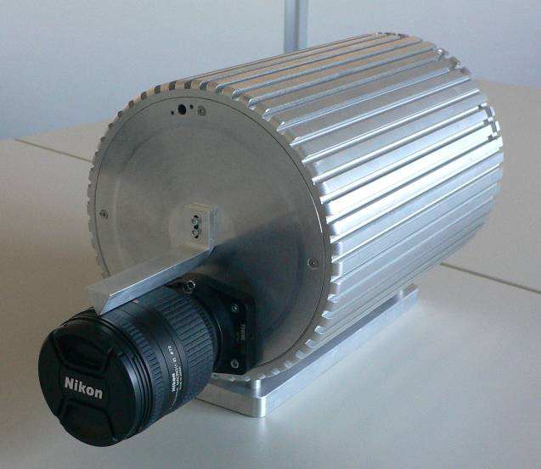
The SPIRIT instrumentation (2/2)
Project evolution:
System characterization
Software and user interface
Development
x Test on phantoms
x Clinical trials
First prototype assembled
7
Notes:
Je ne guarde pas cette dia

Slide 10
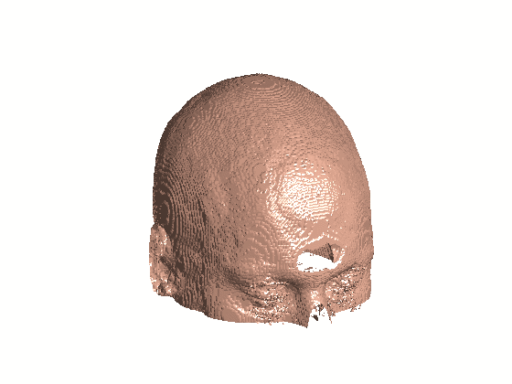
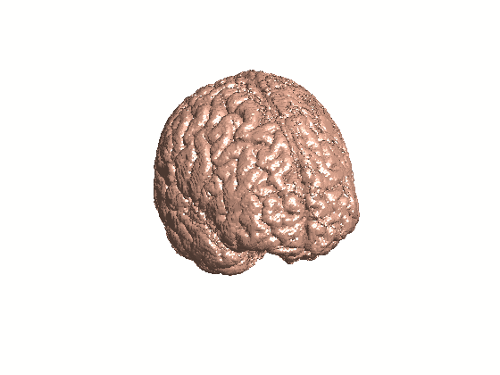
Human optical head phantom (1/3)
From the Brainweb database …
  Head divided in 11 classes
  Each voxel: 11 probability coefficients
  (appartenance to a given class)
… to the optical phantom
Tissues grouped in 6 classes
    Skin (skin, fat, muscle, connective tissue)
    Skull (bone and bone marrow)
    CSF and dura
    Gray Matter
    White Matter
    Vessels
  With available absorption µ_{a} and scattering µ_{s}’ properties in the NIR
B. Aubert-Broche, et al, Neuroimage 2006.
8

Slide 11
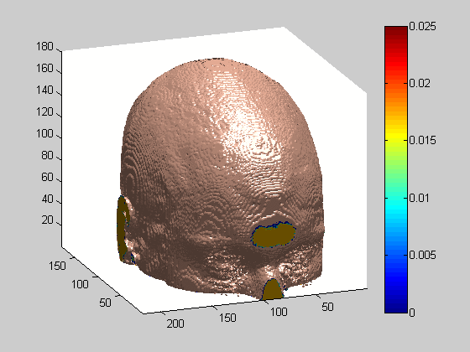
Human optical head phantom (2/3)
Optical properties at 800 nm: from litterature data
3D µ_{a} map
Brain activation CBF CBV µ_{a}
Simulation of brain activation
10% increase of µ_{a} (0.04 mm⁻¹) in an area of the prefrontal cortex (GM)
9

Slide 12
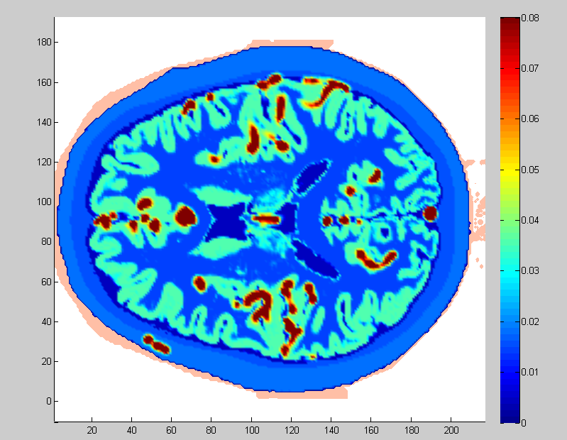
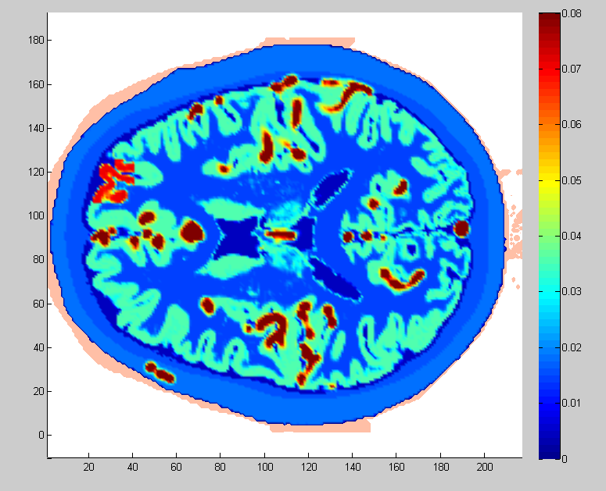
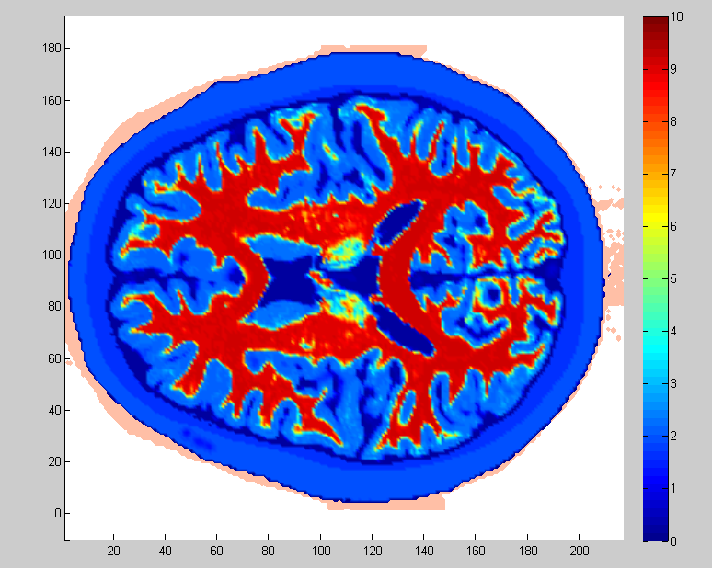
Optical head phantom (3/3)
2D µ_{a} horizontal slice
µ_{a} µ_{a}
at rest activated
(scale not respected)
µ’_{s}
10

Slide 13
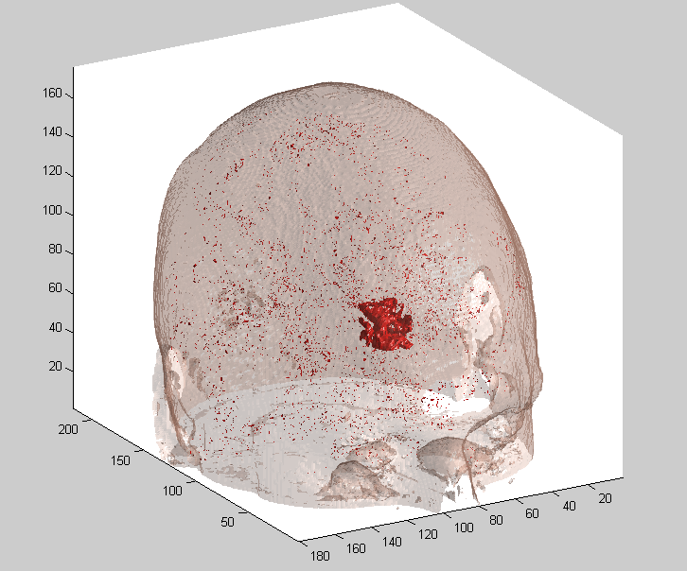
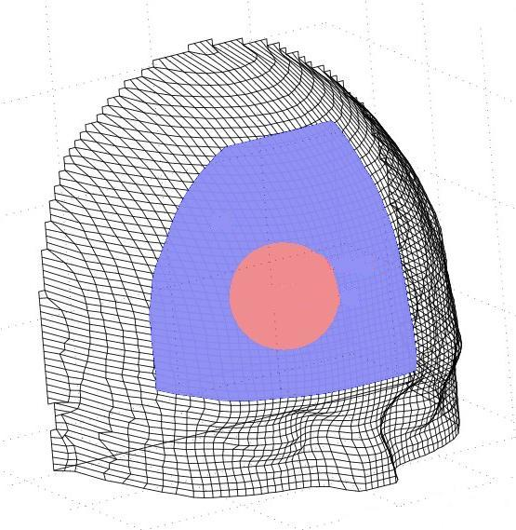
SPIRIT simulations
  Illuminated area: Ø = 50 mm, in front of the activated cortex
  Photon propagation:
  - time-dependent diffusion equation solved by FEM Φ(x,t)
  - computation volume 100x100x60 mm³
  - mesh with 98489 nodes, time step 10 ps
11

Slide 14
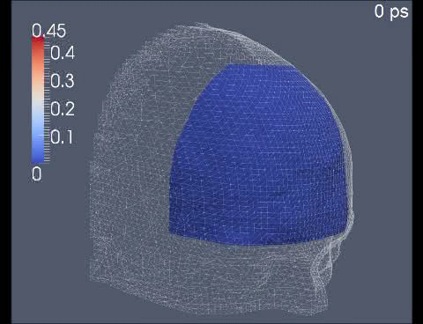
SPIRIT simulations results (1/2)
Maximal difference at 710 ps
Γ_{rest}(x,t)
Γ _{activation}(x,t)
10³(Γ_{rest}-Γ_{activation})
Temporal profiles at point x
Φ_{rest} - Φ_{activation}
12

Slide 15
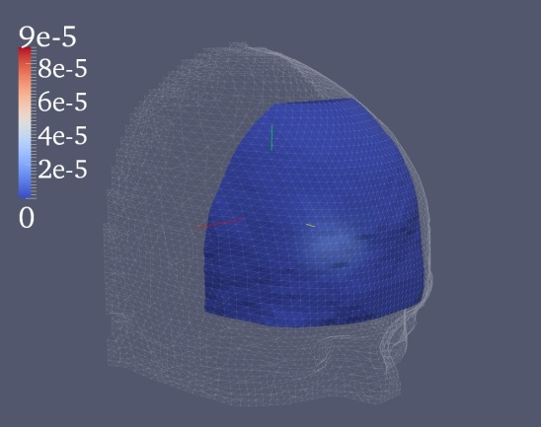
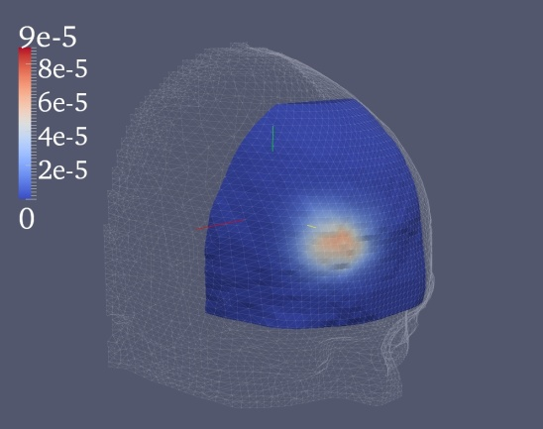
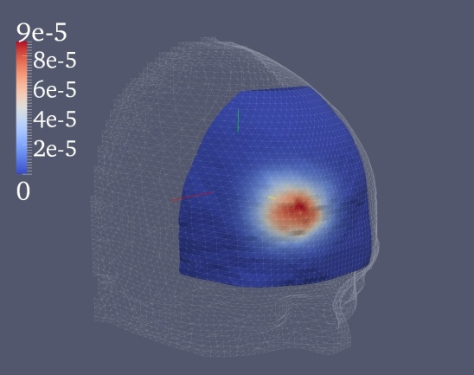
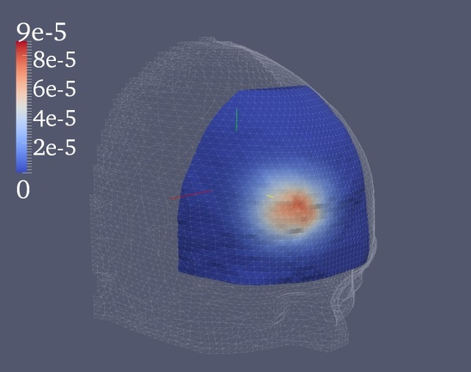
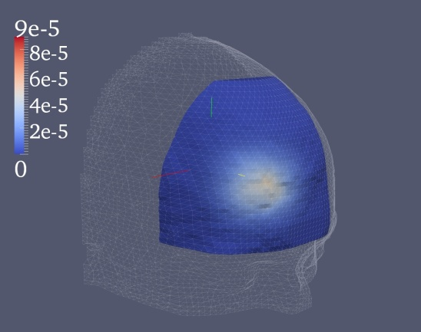
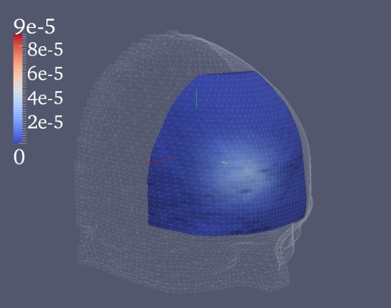
SPIRIT simulations results (2/2)
Differences (rest – activated) of photon density maps summed up on 200 ps periods
200-400 ps
400-600 ps
600-800 ps
800-1000 ps
1000-1200 ps
1200-1400 ps
Maximal difference in the 600-800 ps period, equal to 0.45 % of the photon density at 710 ps.
13

Slide 16
Discussion
Detection feasibility of cortical activation on humans with the SPIRIT system:
Calibration of simulation results with experimental data
  * Mean power 1 mW, pulse repetition rate 40 MHz: 10⁸ photons/pulse
  * Output flow (Brainweb phantom at 800 nm): 10⁷ photons/(s.mm²) on the forehead in the 600 - 800 ps period.
  * 0.38% contrast requires 10⁶ photons on the photocathode
  Contrast / Noise ratio = 1 will be obtained in a 100 ms acquisition with a spatial resolution of 1 mm².
14

Slide 17
Planned clinical applications
Olfactory cortex activity in newborn receiving odor stimuli
  Early diagnosis of the Alzheimer’s disease
Fluorescence Imaging
    SPIRIT diagnosis will be conducted in parallel with neuropsychological testing and other imaging modalities (MRI, PET and SPECT).
15

Slide 18






SPIRIT project financed by
and labeled by

Slide 19
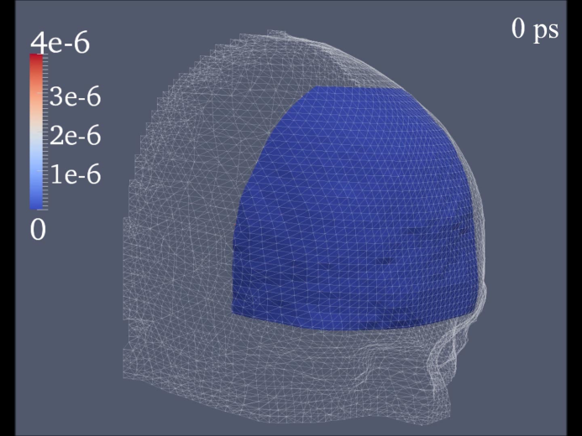



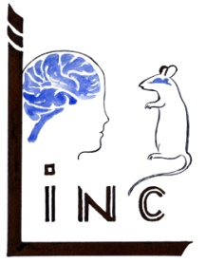
SPIRIT project conducted by
LINC
Marine Amouroux
Gilberto Diaz
François Xavier Blé
Farouk Nouizi
Renée Chabrier
Patrick Poulet
InEES
Benoit Dubois
Wilfried Uhring
Virigine Zint
The companies
Photonis
Montena
Telmat
Thank You !

