Slide 1




A time-gated near-infrared spectroscopic imaging device for clinical applications.
Patrick Poulet, Wilfried Uhring, Walter Hanselmann, René Glazenborg, Farouk Nouizi, Renée Chabrier, Virginie Zint, Werner Hirschi
Icube, Université de Strasbourg / CNRS, France
Montena emc, Montena, Suisse
Photonis, Roden, Netherlands

Slide 2
Outlines
Introduction
Setup
  Principles
  Description
Results
  Setup characteristics
  Evaluation on test objects
Conclusion

Slide 3
Introduction
The objective: to build a time-resolved, no-contact nor scanning, NIRS imaging device
  A time-resolved system to allow depth-resolved data analysis and to be robust to variations in superficial layers,
  No-contact instrumentation to simplify its use and to reduce preparation time (no optical fiber to position in contact with the head),
  No scanning to increase time resolution, by illuminating a large area on the body surface.
The SPIRIT consortium
  2 labs (now merged) from the University of Strasbourg University and the “Centre National de la Recherche Scientifique”, CNRS,
  3 companies: Photonis, Montena and Telmat.
The instrument: a unique setup
  4 laser diodes,
  1 time-gated camera, image intensifier + CCD camera,
  1 sequencer to generate the trigge.r signals for the proper operation of the whole system.

Slide 4
The SPIRIT Device
Operation principles
  Picosecond near infrared source → frontal light distributor → uniform illumination spot,
  Lens + time-gated intensified camera → 3D time of flight maps,
  USB + Ethernet connection to a PC for acquisition control and data processing.

Slide 5
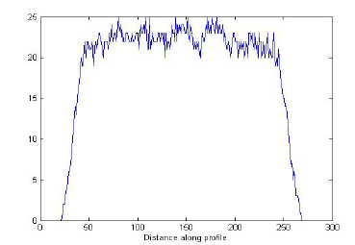
The SPIRIT Device
Description: the light source
  4 near infrared laser diodes, driven by a ns pulse generator in a sequential mode at 100 MHz repetition rate.
  A four-furcated optical fiber ended with a single frontal light distributor.
Illumination spot
  ≈ 60 ps (FWHM)
  some cm, uniform,
  circular spot

Slide 6
The SPIRIT Device
Description: the intensified camera
  Image intensifier tube and its associated pulse generator.
    Electrical pulses of some hundred of picoseconds.
    Photocathode redesigned for ultrafast gating capabilities.
    Coupling of the intensifier to a 12 bit monochrome CCD camera.
    IEEE 802.3ab interface.
  Filter wheel
    Polarizer
    Fluorescence filters

Slide 7
The SPIRIT Device
Description: the sequencer
  1 FPGA based module generates the pulses sequence for
    the laser diodes,
    the intensifier photocathode,
    the CCD camera trigger,
    the filter wheel.

Slide 8
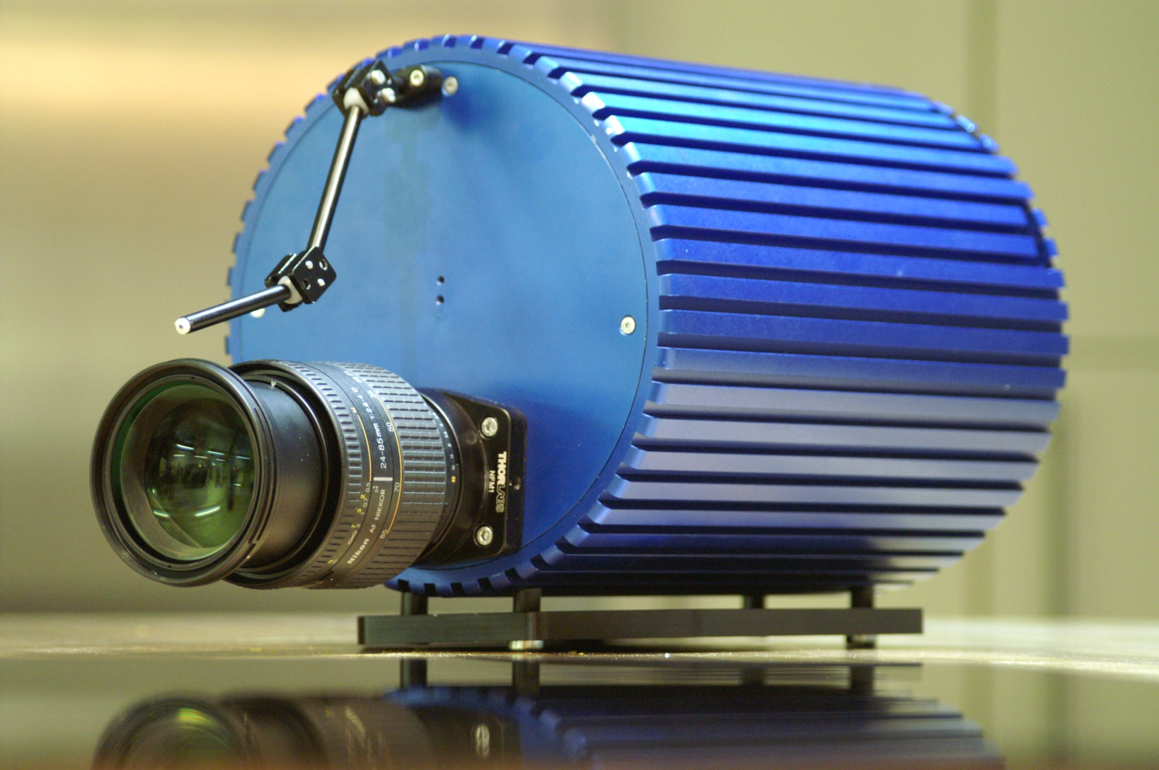
The SPIRIT Device
External view of the setup, including the picosecond laser diodes and the time-gated intensified camera

Slide 9
The SPIRIT characteristics
Light sources
  < 80 ps FWHM pulse widths,
  655, 785, 830 and 870 nm wavelengths,
  Single mode ps optical pulses.
Intensifier tube: new photocathode shape
  Aperture of the image intensifier completed in less than 70 ps,
  Temporal gate < 200 ps,
  Position of the gate in the range 0 to 18.4 ns with a time step of 9 ps,
  Reduced electrical loss: 80 to 105 MHz repetition rate (int./ext. clock).
Intensifier tube: new sub ns driver
  Matching section between the generator and photocathode,
  Pulse train > 50 V at 100 MHz.

Slide 10
Acquisition principles
A sequence acquisition consists in acquiring
  M images I (I = 1:M) for each wavelength j (j = 1:N),
  An image i corresponds to a temporal position i of the gate.
  Interlacing the wavelengths and the temporal positions: acquisition of M x N 2D images

Slide 11
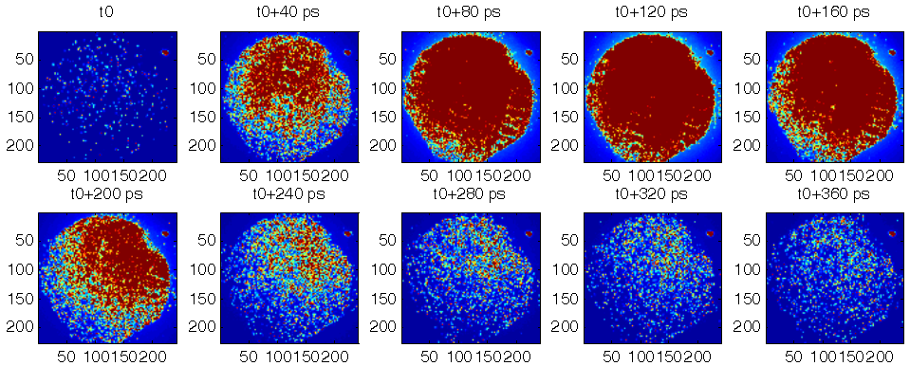
Results
Temporal resolution (time gated camera)
  Titanium sapphire laser at 800 nm, lighting a white paper screen, laser pulse < 8 ps FWHM. Inter-frame delay 40 ps.
  Total aperture of the image intensifier < 80 ps
  Temporal gate width < 200 ps.

Slide 12
Results
Temporal resolution (whole SPIRIT device)
  Laser diode (830 nm) pulse width = 75 ps FWHM (measured using a streak camera)
  Total measured width (FWHM) = 210 ps (laser diode + ICCD camera)

Slide 13
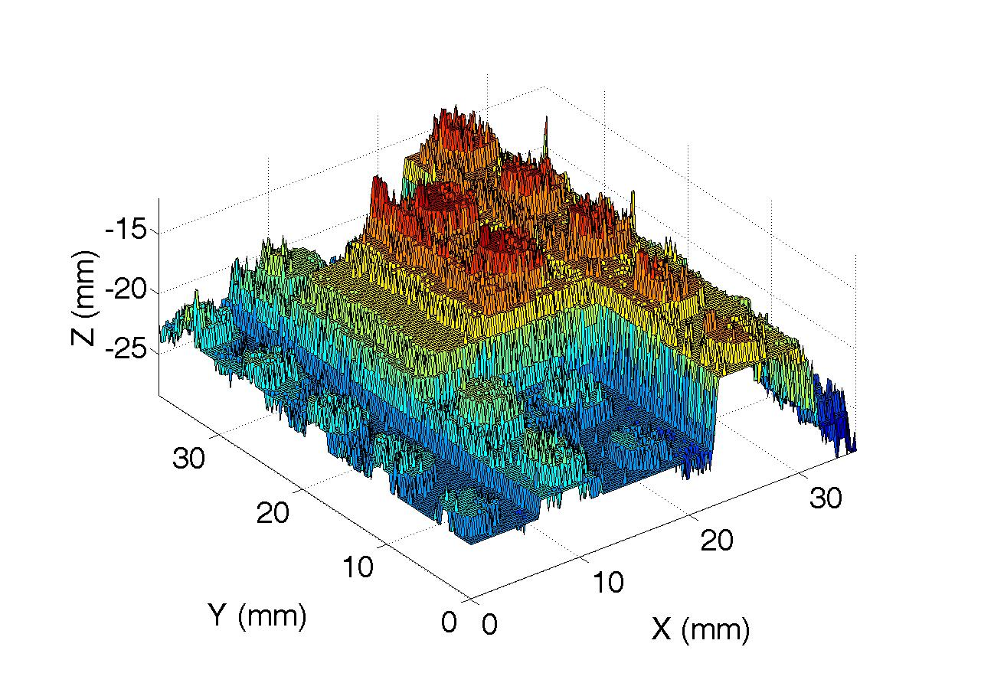
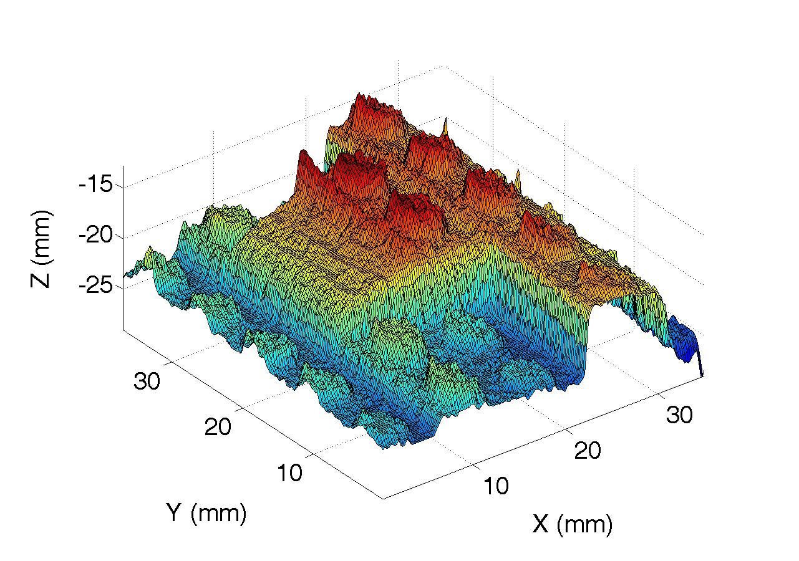
Test objects
3D Surface imaging: Image of LEGO bricks
  30 ms acquisition time per image, 40 gate positions, 10 ps step
  Surface position computed from the time gate at ½ height
  Spatial Resolution: 0.2 x 0.2 x 1.5 mm
  without data processing filtered image

Slide 14
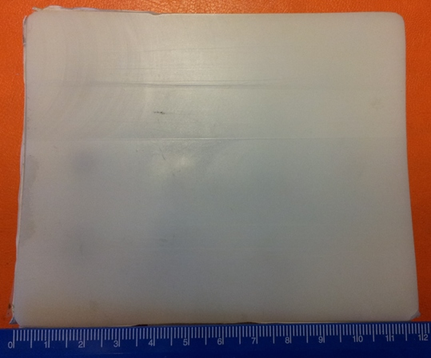
Test objects
The phantom
  23 mm thick polyester resin block, 120 x 95 mm.
  Titanium oxide particles + black India ink: background reduced scattering (µ_{s}’) and absorption (µ_{a}) coefficients (µ_{a} = 0.005 mm⁻¹, µ_{s}’ = 0.9 mm⁻¹)
  Absorbing rods: top at 3.5 5 9 11 mm under surface
  µ_{a} x 10, 30 or 100
x 10
x 30
x 100
Imaged area

Slide 15
Test objects
Single shot acquisitions
  30 ms acquisition time per image
  100 time gate positions, 10 ps step
  The brighter image (Im(0)) is used as a reference and the corresponding time as the origin.
  Absorbance images A(t) are computed from the successive images Im(t) using:

Slide 16

Test objects
Absorbance images and profiles
  t = 250 ps t = 500 ps
  Absorbing rods at depth ≤ 5 mm and µ_{a} > 30 x are detected.
  Absorption profiles depend on:
  -the depth of the inclusion through its delay
    - the absorbance of the inclusion through its amplitude
  The “absorption” images appear increasingly blurred, due to photons scattering, when the gate’s delay increases.

Slide 17
Conclusion and outlooks
A 2D near infrared time resolved spectroscopic imaging device has been assembled.
The special design of the intensifier tube and its associated pulse generator allows an ultrafast gating operation down to 200 ps FWHM at a repetition rate of 100 MHz.
The whole system is compact and entirely configurable by software via a USB plug.
The human machine interface and data analysis software are under development.
Some advantages result from the device’s conception. It is contact free, scan free, with no hot spot, and it is suited for time resolved tomography.

Slide 18
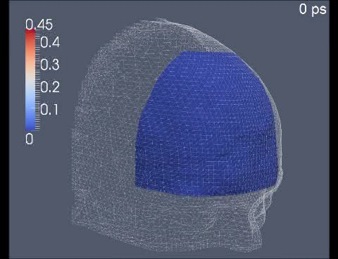
Conclusion and outlooks
The compactness of the device makes it suitable for bedside clinical applications, including near infrared spectroscopic imaging, diffuse optical tomography and fluorescence molecular tomography.
Time resolved photon density differences map, on the surface of the head, between “at rest” and “activated” periods.

Slide 19
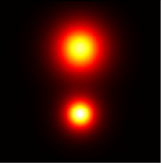

Conclusion and outlooks
The compactness of the device makes it suitable for bedside clinical applications, including near infrared spectroscopic imaging, diffuse optical tomography and fluorescence molecular tomography.
Time (ns)
0 2.5
Time resolved photon density differences map, on the surface of the head, between “at rest” and “activated” periods.
DC (left) and TR (right) fluorescence images of 2 inclusions: 1 small, deep and highly fluorescent (top) and 1 large and superficial (bottom).

Slide 20






Acknowlegments
Work performed with the financial assistance of:
  Region Alsace,
  Region Limousin,
  “Direction générale de la compétitivité, de l'industrie et des services” (DGCIS)
  OSEO
Work labeled by:
  Alsace BioValley
  Cancer Bio Santé Toulouse
Thank You !

